Slide 1


Prepared By: Enrollment No.: 201303100910043 Name: Aarzin M. Todiwala Semester: 6th semester Department: Comupter Engg guided By: faculty: Mr. Dipak dabhi designation: asst. proffesor department: Co/it department
“Phishing Detection on Websites”
CGPIT

Slide 2
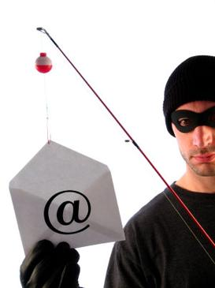
Phishing[3]

Slide 3
What is phishing?
Phishing is the attempt to acquire sensitive information such as usernames, passwords, and credit card details (and sometimes, indirectly, money), often for malicious reasons, by masquerading as a trustworthy entity in an electronic communication.[3]
Phisher-man: A person who hacks our details.[3]
Notes:
Phishing is typically carried out by email spoofing^{[4]} or instant messaging,^{[5]} and it often directs users to enter details at a fake website whose look and feel are almost identical to the legitimate one
As per the research it was 106421 phishing scams all over world in oct 2015.

Slide 4
Literature Survey:
Paper:1=> Approximate String Matching Algorithm for Phishing Detection.
Many methods have been developed to fight against phishing attacks.
But, as the attacker uses more sophisticated techniques each method fails to perform well in detecting the attacks.
Here we propose a string matching method for detecting phishing attacks, which determines the degree of similarity a URL is having with the blacklisted URLs.
Thus based on the textual properties of a URL it can be classified as phishing or non-phishing. Two string matching algorithms i.e. Longest Common Subsequence (LCS) and Edit Distance are used in the hostname comparison.
The accuracy rate obtained for LCS is 99.1% and for Edit Distance it is 99.5%.

Slide 5
Literature Survey:
Paper:2=> Intelligent Phishing Website Detection and Prevention System by Using Link Guard Algorithm
By utilizing the generic characteristics of the hyperlinks in phishing attacks.
These characteristics are derived by analyzing the phishing data archive provided by the Anti-Phishing Working Group (APWG).
Because it is based on the generic characteristics of phishing attacks, Link Guard can detect not only known but also unknown phishing attacks.
We have implemented Link Guard in Windows XP. Our experiments verified that Link Guard is effective to detect and prevent both known and unknown phishing attacks with minimal false negatives.
Link Guard successfully detects 195 out of the 203 phishing attacks. Our experiments also showed that Link Guard is light weighted and can detect and prevent phishing attacks in real time.

Slide 6
Types Of Phishing:
Phishing
Sphere Phishing
Clone Phishing
Whaling
Notes:
Phishing:
An attempt to acquire information such as usernames, passwords, and credit card details by masquerading as a trustworthy entity in an electronic communication. In October 2013, emails purporting to be from American Express were sent to an unknown number of recipients. A simple DNS change could have been made to thwart this spoofed email, but American Express failed to make any changes.
Spear phishing:
Phishing attempts directed at specific individuals or companies have been termed spear phishing.^{[43]} Attackers may gather personal information about their target to increase their probability of success. This technique is, by far, the most successful on the internet today, accounting for 91% of attacks.
Clone phishing:
A type of phishing attack whereby a legitimate, and previously delivered, email containing an attachment or link has had its content and recipient address(es) taken and used to create an almost identical or cloned email. The attachment or link within the email is replaced with a malicious version and then sent from an email address spoofed to appear to come from the original sender. It may claim to be a resend of the original or an updated version to the original. This technique could be used to pivot (indirectly) from a previously infected machine and gain a foothold on another machine, by exploiting the social trust associated with the inferred connection due to both parties receiving the original email.
Whaling:
Several recent phishing attacks have been directed specifically at senior executives and other high profile targets within businesses, and the term whaling has been coined for these kinds of attacks.^{[45]} In the case of whaling, the masquerading web page/email will take a more serious executive-level form. The content will be crafted to target an upper manager and the person's role in the company. The content of a whaling attack email is often written as a legal subpoena, customer complaint, or executive issue. Whaling scam emails are designed to masquerade as a critical business email, sent from a legitimate business authority. The content is meant to be tailored for upper management, and usually involves some kind of falsified company-wide concern. Whaling phishermen have also forged official-looking FBI subpoena emails, and claimed that the manager needs to click a link and install special software to view the subpoena.

Slide 7
Approaches to Prevent Phishing Attacks :
Detect and block the phishing Web sites in time.[2]
Enhance the security of the web sites.[2]
Block the phishing e-mails by various spam filters.[2]
Install online anti-phishing software in user’s computers.[2]

Slide 8
Algorithm For phishing detection
URL Classification.
Link-Guard Algorithm.

Slide 9
URL CLASsification:

Slide 10
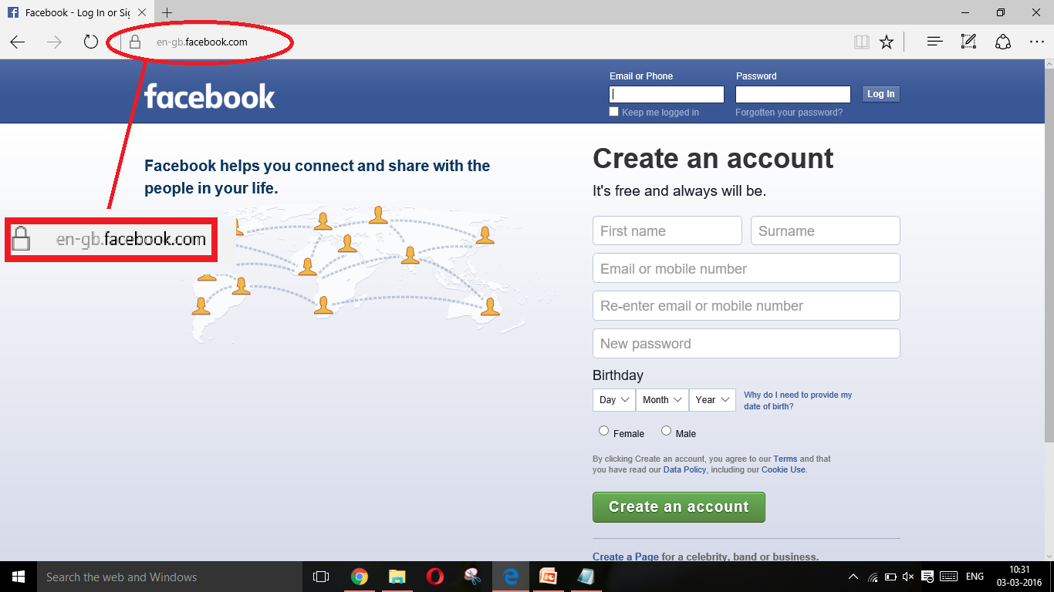
By Explaining Example Of Phishing:
Original Site

Slide 11
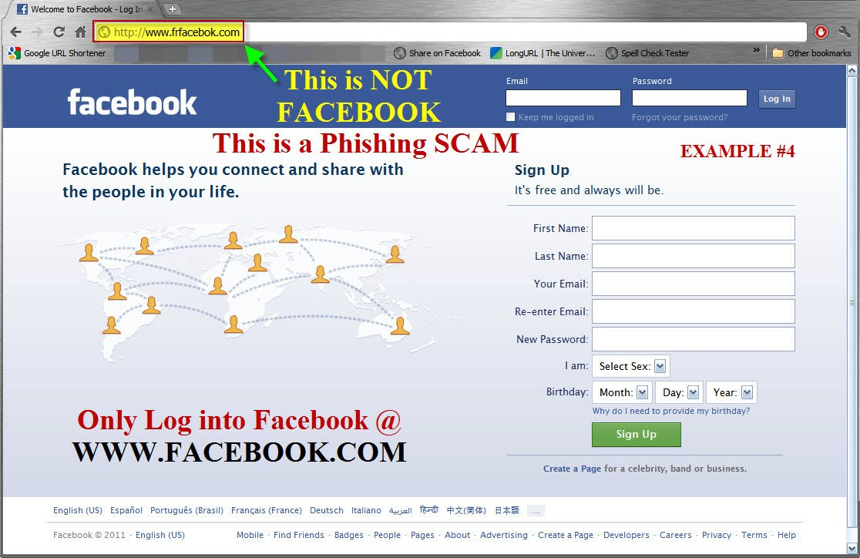
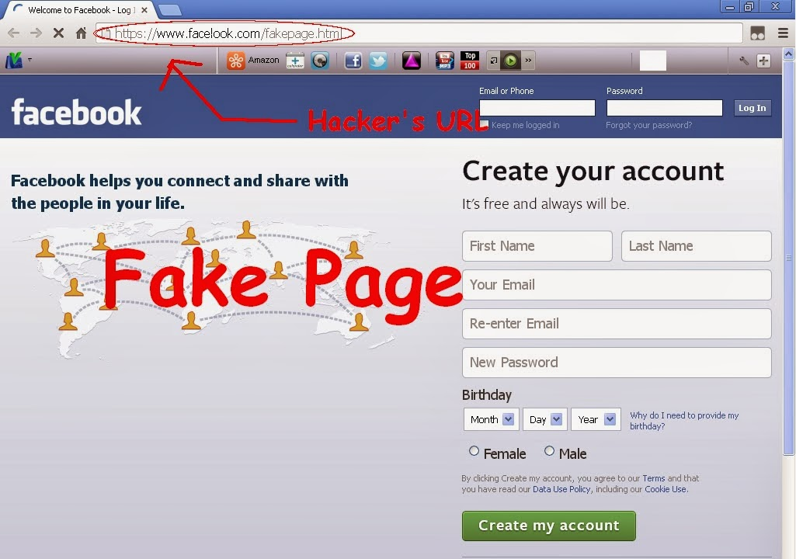

Slide 12
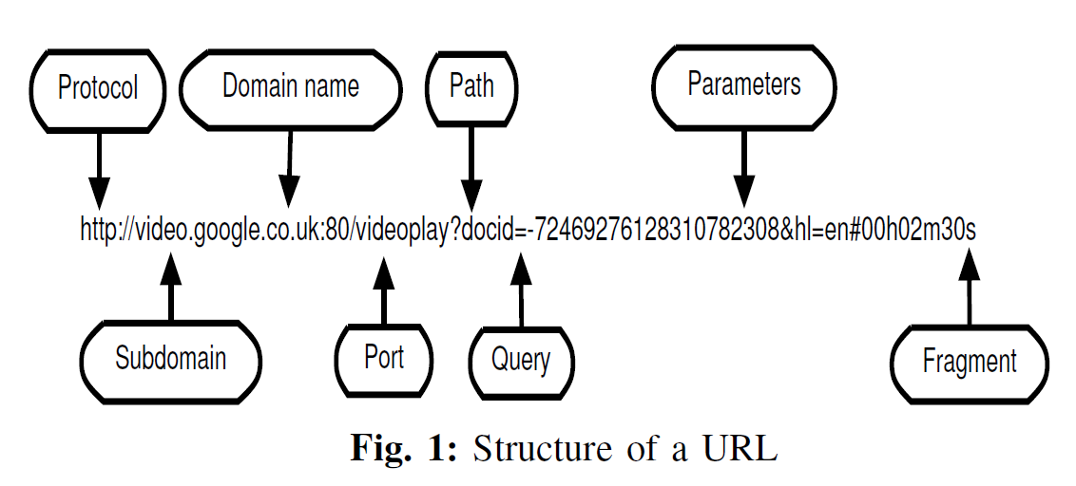
[1]

Slide 13
Method of URL Classification:

Slide 14
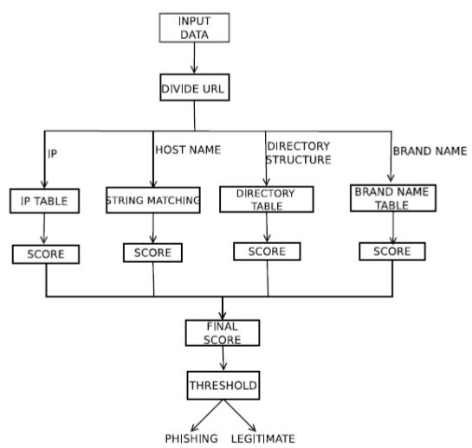
[1]
[1]

Slide 15

For ip Address:[1]

Slide 16
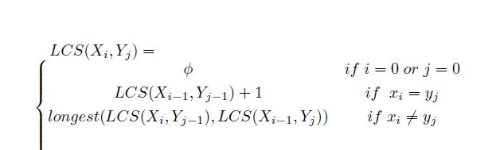
For host name:[1] 1. lcs

Slide 17
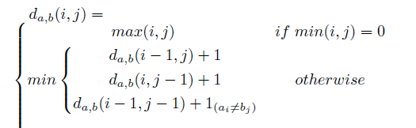

For host name:[1] 2. Edit distance

Slide 18
Directory Structure:
Directory structure acquires the location of the requested source on web server.[1]
By changing the filename of a URL, phishers can launch any number of attacks from a single directory.[1]
The directories of each URL is organised to an indexed table as in the case of IP then the score for each directory is calculated based on the equation 1 where n_{i} being the number of URLs with same directory.[1]

Slide 19
Brand name:
Phisher usually target on well reputed sites where money transactions take place.[1]
Based on the PhishTank reports the affected brands are online shopping sites line Paypal, eBay, and bank websites. [1]
A list of most affected brand names are generated with the help of PhishTank reports.[1]
In our method, we check for the existence of any of these brands in the URL and a score is assigned based on the frequency of it using the equation(1).[1]

Slide 20
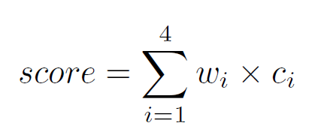
Sumation:[1]

Slide 21
Link-guard Algorithm

Slide 22
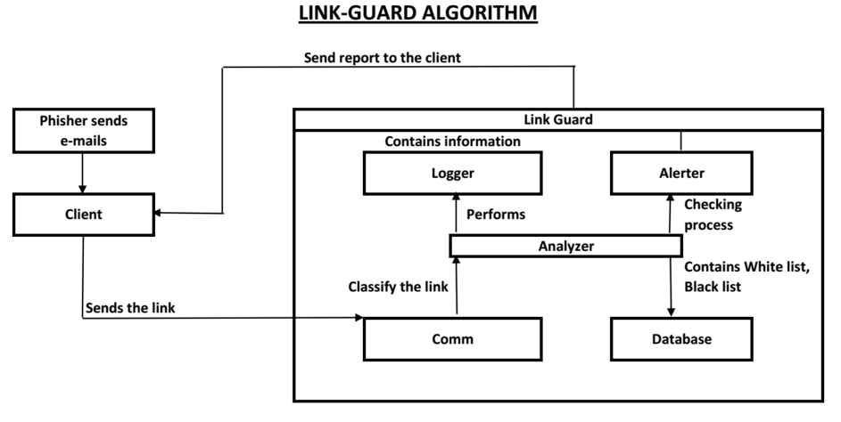
[2]

Slide 23
Diffrence between Link Guard Algo and URL Classification Algo:
Link-Guard
URL
Using some software like:BHO(browser helper object) and SetWinEventHook.[2]
It is used for Emails.[2]
It can’t identify websites spoofing.[2]
It has 96% Accuracy.[2]
Using some formulas we can derive the phishing attack.[1]
It is used for websites.[1]
It can also identify email spoofing.[1]
It has 99% Accuracy.[1]

Slide 24
Conclusion:
Phishing has becoming a serious network security problem, causing finical lose of billions of dollars to both consumers and e-commerce companies.
In this research paper, we have studied the characteristics of the hyperlinks that were embedded in phishing e-mails. We then designed an anti phishing algorithm, Link-Guard, based on the derived characteristics and URL classification.

Slide 25
Reference:
[1] Dona Abraham and Nisha S. Raj, Approximate String Matching Algorithm for Phishing Detection,In SCMS School of Enggineering and Technology,2014 IEEE.
[2] U. Naresh , U. Vidya Sagar and C.V.Madhusudan Reddy,Intelligent Phishing Website Detection and Prevention System by Using Link Guard Algorithm, IOSR Journal of Computer Engineering, 2013.
[3]www.google.com

Slide 26
Thank you

